Slide 1
Email Spam Classification using NLP
By Soumya Tarate

Slide 2
PROBLEM STATEMENT :
The increasing number of spam emails creates security risks and wastes user time. Accurately classifying emails as spam or ham using Natural Language Processing and Machine Learning techniques.
OBJECTIVES :
To classify emails as Spam or Ham (Not Spam)
To apply Natural Language Processing (NLP) techniques
To train a Machine Learning model
To evaluate the model using accuracy and performance metrics
DATASET RESOURCE :
Kaggle Dataset

Slide 3
Dataset Structure & Initial Analysis
Label Distribution
Countplot analysis reveals the balance between spam and ham categories, informing model training strategies.
Feature Engineering
Text preprocessing including tokenisation, stopword removal, and vectorisation to transform raw text into numerical features.
Dataset source: Kaggle Spam vs Ham Dataset
Contains thousands of labeled email messages
Two classes:
  Spam
  Ham
Each record contains email text and its category
This dataset is suitable for text classification tasks.

Slide 4
Methodology: Model Development Process
Data Loading
Feature Extraction
Model Training
Performance Evaluation
Preprocessing

Slide 5
NLP Preprocessing Pipeline
Lowercasing : Convert all text to lowercase to ensure consistent representation regardless of original capitalization.
Punctuation Removal :Remove punctuation marks, special characters, and symbols that don't contribute to spam detection.
Tokenization : Break text into individual words or tokens for analysis and feature extraction.
Stopword Removal : Eliminate common words (the, is, at, which, etc.) that add noise without meaningful signal.
Text Vectorization : Convert cleaned text into numerical format using Bag of Words or TF-IDF for machine learning.

Slide 6
Model Performance Metrics
Accuracy Score
Overall correctness of classifications, calculated as (True Positives + True Negatives) / Total Predictions.
Confusion Matrix
Visual representation of correct and incorrect predictions, showing true positives, false positives, true negatives, and false negatives.
Classification Report
Detailed breakdown including precision, recall, and F1-score for each class (spam and ham).

Slide 7
Key Evaluation Metrics
1. Precision
Proportion of correctly identified spam emails among all emails classified as spam. High precision means fewer false alarms.
2. Recall
Proportion of actual spam emails correctly identified. High recall means fewer spam messages missed.
3. F1-Score
Harmonic mean of precision and recall, providing a balanced measure of model performance across both metrics.

Slide 8
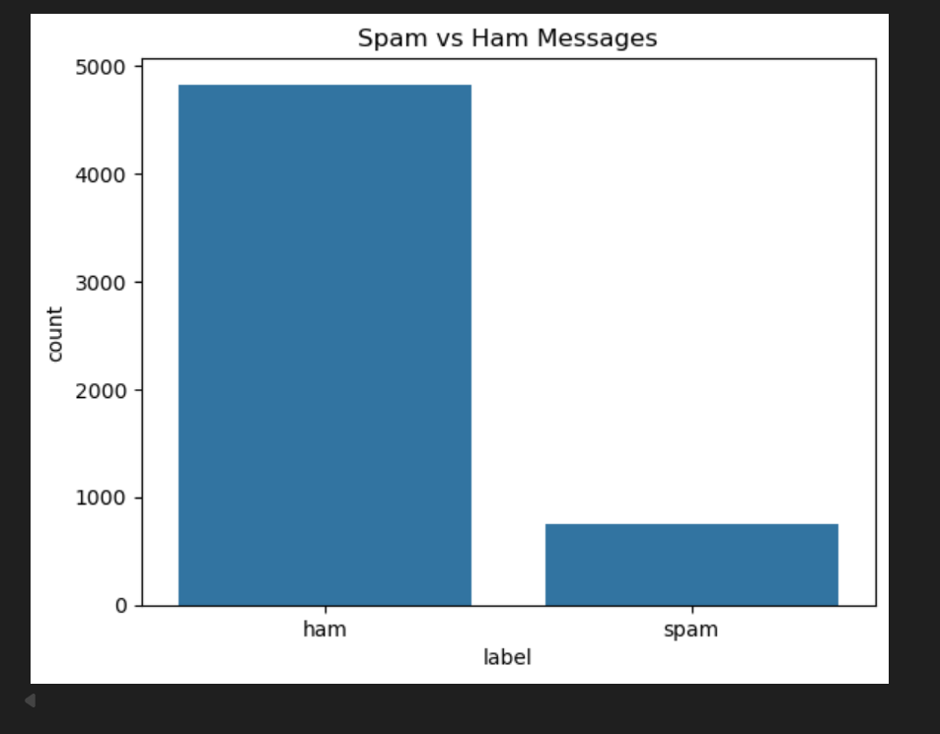
OUTPUT 1
This countplot shows the distribution of spam and ham messages in the dataset.
The number of ham (legitimate) messages is much higher than spam messages.

Slide 9
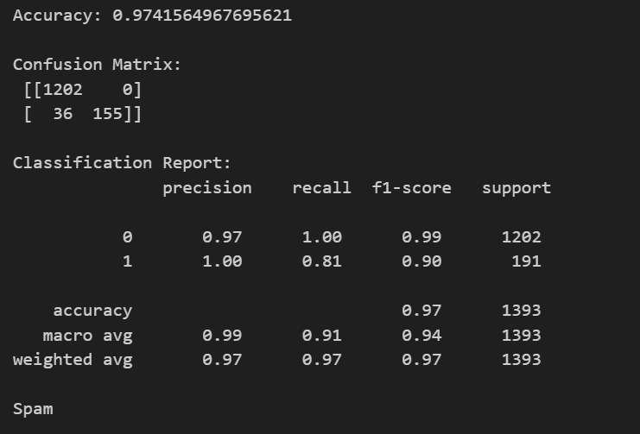
OUTPUT 2
Accuacy : 97.41% - The model correctly classifies about 97 out of 100 emails, which shows that the classifier performs very well on unseen data.
Confusion Matrix : No ham email was wrongly marked as spam.
Classification Report :
Description:
The model has perfect recall for ham (1.00)
Spam detection recall is 0.81, meaning most spam is caught
High F1-scores show a balanced and reliable model

Slide 10
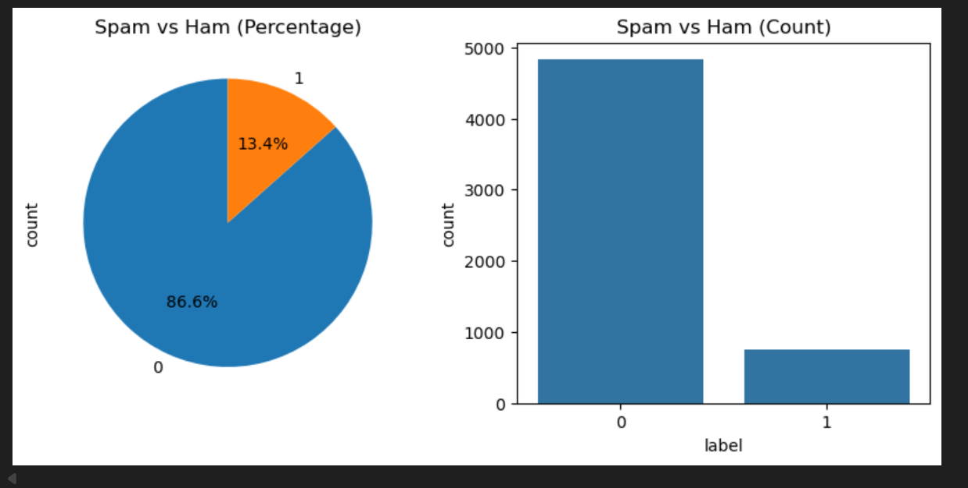
OUTPUT 3
The pie chart shows that 86.6% of the emails are ham and 13.4% are spam.
The bar graph again confirms that ham messages dominate the dataset.

